Slide 1
New Infrastructure Development : Designing Solutions for a Collective Action Problem
Nuno Gil
Professor of New Infrastructure Development
Manchester Business School
Highways England Research Alliance Workshop
Salford, November, 2015
© Nuno A. Gil. All Rights Reserved
Notes:
Like a kaleidoscope in which the view changes as it is rotated, any collaboration can be transformed as issues are addressed in this way

Slide 2
Research Capabilities
We’re a research unit based in a Business school
Interdisciplinary team: management scholars but differing backgrounds
Focus: New infrastructure Development
Systems approach: from front-end planning to project handover
Production problem: capital-intensive, long-lived designed prototype
Political problem: do not suppress stakeholders’ interests
© Nuno A. Gil. All Rights Reserved

Slide 3
Opportunity with Highways England: Research the Project Front-end
Front-end Planning: ‘Wicked….messy… feels too democratic….I wish all these stakeholders could disappear’
Sets Performance Baseline: Budget + timescale + scope
Two Managerial Approaches :
MY project: Frame everyone else as External Stakeholder
OUR project: Frame key stakeholders as Development Partners, Consult others (democratic up to a point)
© Nuno A. Gil. All Rights Reserved

Slide 4
Planning: Source of Major Slippages in Performance Targets
Early contractor involvement
Projected
Planning
Delivery
© Nuno A. Gil. All Rights Reserved

Slide 5
Some Current Research Projects
w/ Rehema Msulwa (PhD): Governance of Front-end Project Planning
w/ Franziska Drews (PhD): Procurement Strategies under Uncertainty
W/ Professor Jim Freeman: Can we Predict Final Project Cost as a function of: i) Stakeholder arrival sequence, ii) Governance structure
w/ Colm Lundrigan (PhD) : Strategic Capabilities for Project Promoters
w/ Yongcheng Fu (PhD): Project Planning: Insights from Game Theory
© Nuno A. Gil. All Rights Reserved

Slide 6
Optimism bias: self-fulfilling prophecy?
Projected
Ideation
Planning
Delivery
© Nuno A. Gil. All Rights Reserved

Slide 7
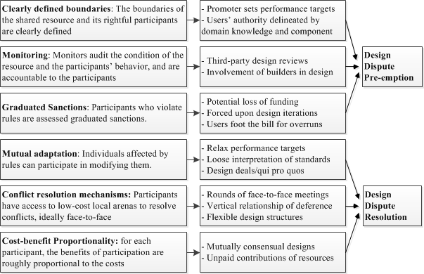
Can we Develop a Commons Logic? Yes

Slide 8
Planning: Source of Major Slippages in Performance Targets
© Nuno A. Gil. All Rights Reserved

Slide 9
Some Ongoing Research Projects
w/ Colm Lundrigan (PhD) : Strategic capabilities for megaproject architects
w/ Rehema Msulwa (PhD): Governance of High-speed 2: why do some groups do better in converging interests than others?
w/ Franziska Drews (PhD): Drivers to design Contracting and Procurement Strategies
W/ Professor Jim Freeman: Evolution of Cost Forecast = f (Arrival of Stakeholders, Governance Structure)
w/ Yongcheng Fu (PhD): Project Planning: Insights from Game Theory
© Nuno A. Gil. All Rights Reserved

Slide 10
Commons Governance
Can we develop a ‘commons’ logic under time pressure, financial constraints, differing interests and needs?
Can we frame strategic choices as ‘shared’ resource?
How can we encourage social norms of cooperation to flourish: reciprocation, compromise-seeking, trust?
Can we resolve disputes without recourse to external umpires /referees (Courts, Parliament/Hybrid bills)?
© Nuno A. Gil. All Rights Reserved

Slide 11
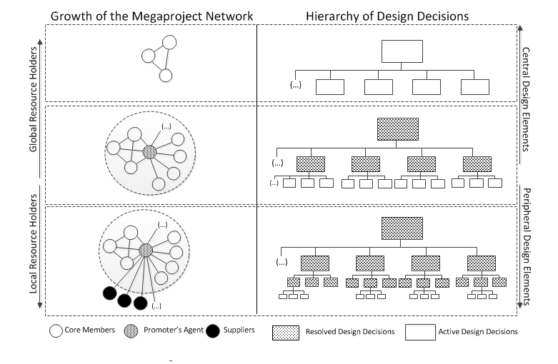
Strategic Capabilities: Bottleneck Removal

Slide 12
Front-end Governance: A Collective Action Problem
No contracts: To achieve formal agreements is the goal
No Authority Hierarchy: Different stakeholders control different resources (land, capital, planning consent, knowledge, political support)
No Meritocracy-based Authority (Relational Contract): Robust relational contracts take a long time to forge (and there’s no time)
Planning is therefore a consensus-oriented, deliberative process…but emergence of a bargaining structure is inevitable
© Nuno A. Gil. All Rights Reserved

Slide 13
Unresolved Planning Disputes: Major Source of Uncertainty in Delivery
In a 3-year, £300m sub-project, 1,000 claims (~one claim/day)
© Nuno A. Gil. All Rights Reserved

